Slide 1
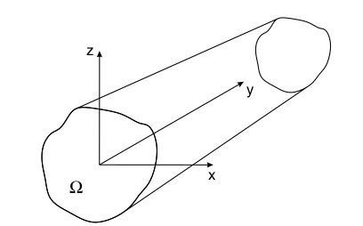
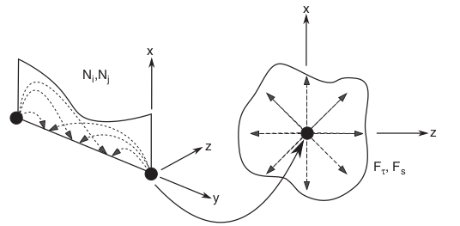
Static analysis of beam structures using refined 1D beam model
Presented by : Arun Prakash Ganapathy(63876) Supervised by: Mr. Jeffy Sabu Abraham

Slide 2
INTRODUCTION
Beam structures are widely used in many engineering applications such as aircraft wings,helicopter blades, concrete beams in constructions etc.,
Classical 1-D models for beams made of isotropic materials are based on Euler-Bernoulli beam and Timoshenko theories. They yield better result for slender beams than short beams.
1D refined models use polynomial expansions(like Taylor,Lagrange polynomials etc.,) to approximate the displacement values across the cross section of the beam.
FE discretization on the axis of the beam element (1D) and an expansion across the cross section which gives the displacement field.
The displacement function can be written in the compact form as
u = N_{i}(y)F_{τ}(x,z)u_{τi} τ = 1,2,3...M i = 1,2...

Slide 3
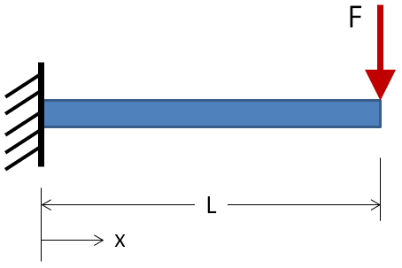
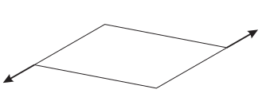
AIM
a
a
Cantilever beam with bending load
Torsional load
Isotropic material of Young’s modulus E and Poisson’s ratio ν is used for the analysis of the structure
The aim of this project is to write an FE solver code to compute the displacements, strains and stresses across the cross-section of the beam using refined 1D models and to compare with conventional beam theories and FEM software models (For a B4 element)

Slide 4
Theory involved
The basic governing equation behind the analysis of static response by principle of virtual displacement is given by the eqn δL_{int} = δL_{ext}
In case of refined 1D models the virtual variation of the internal work is given by δL_{int} = ∫δε^{T} σ dv = δu_{sj} k^{τsij} u_{τ,} where k^{τsij} is the index notation of the stiffness matrix and u_{τ} is the vector unknown displacements. τ,s are expansion function indexes and i,j are shape function indexes
And the external work is given by δL_{ext} = P δu^{T} = F_{τ} Pδu_{τ}^{T} where F_{τ} is the expansion function across the cross section
The expansion function considered here are the taylor-like expansion of the displacement variables across the cross section of the beam

Slide 5
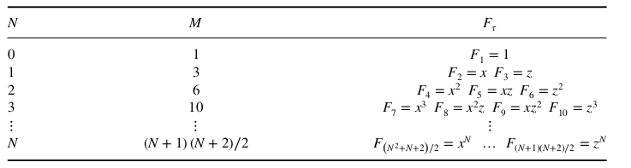
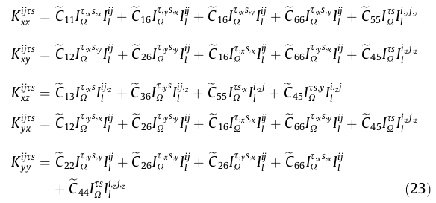
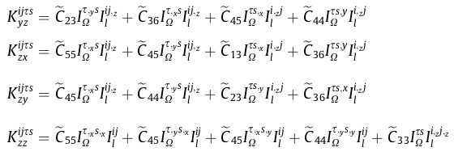
Taylor expansion polynomials:
Fundamental nuclei for creating stiffness matrix k^{τsij} :
Source: Finite element analysis of structure through unified formulation(Book by E.Carrera et al)

Slide 6
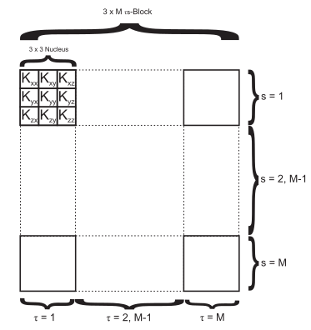
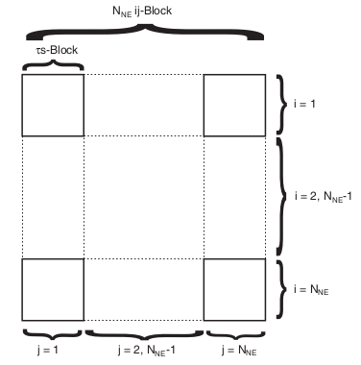
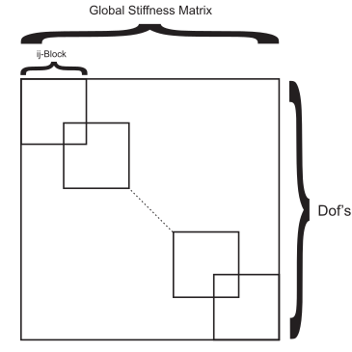
Example:
For a linear beam element(B2) with linear cross section approximation(N=1) T,s = 1,2,3 and i,j=1,2 F₁ = 1, F₂= x, F₃ = Z N₁ = 1 – (y/L), N₂ = y/L
Source: Finite element analysis of structure through unified formulation(Book by E.Carrera et al)
Structure of the stiffness matrix k^{τsij}:

Slide 7

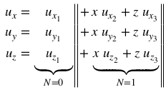
Program structure for creating stiffness matrix k^{τsij}:
For cycle on beam elements:
For cycle on beam nodes i:
For cycle on beam nodes j:
For cycle on expansion functions τ:
For cycle on expansion functions s:
3 x 3 array of Fundamental
nucleus expression
End
End
End
End
The unknown displacement components for the given case will be
From the displacement components obtained the x,y and z displacement (u_{x},u_{y},u_{z}) of any point in the cross section can be obtained using the Taylor expansion
Source: Finite element analysis of structure through unified formulation(Book by E.Carrera et al)

Slide 8
Milestones/Code Structure
The programming language used for this project is Python
Parameter file – Contains inputs like no and type of the element, coordinates of the node, order of the expansion function(N), material properties etc.,
Element routine – Computes the nodal, element stiffness matrix
Material routine – Contains C matrix and the material coefficients
Subroutine for creating global stiffness matrix and solving the governing equation δL_{int} = δL_{ext} to obtain unknown displacements.
Post-processing Phase – Function that computes strains and stresses from the displacement values
Plotting Phase – Using Matplotlib to visualize the results obtained

Slide 9
Code testing details
The functionality of the code is tested by taking the simple test case such as 1 FEM element, with N=1 approximation order across the cross section and comparing it with the analytical solution provided in the paper ‘Refined beam elements with arbitrary cross-section geometries by E. Carrera et al’
The results are validated by comparing it with programmatic results provided in the paper mentioned above for the same test cases
The results are also validated by comparing it with the results obtained from commercial FEM softwares (Abaqus or NASTRAN)

Slide 10
Schedule
Week 1 to 4 - Understanding the numerical concepts behind the problem and coding them
Week 4 to 6 - Creating parameter file and subroutine for mesh
Week 6 to 10 - Coding the element routine which computes nodal and element stiffness matrix
Week 10 to 13 - Coding the subroutine which creates global stiffness matrix and solve for unknown displacements
Week 13 to 16 - Coding the post processing phase which computes the strains and stresses and plots them
Week 17 to 20 - Testing the code (Verification and validation)
Week 21 and 22 - Preparation of the report and final check

